Slide 1
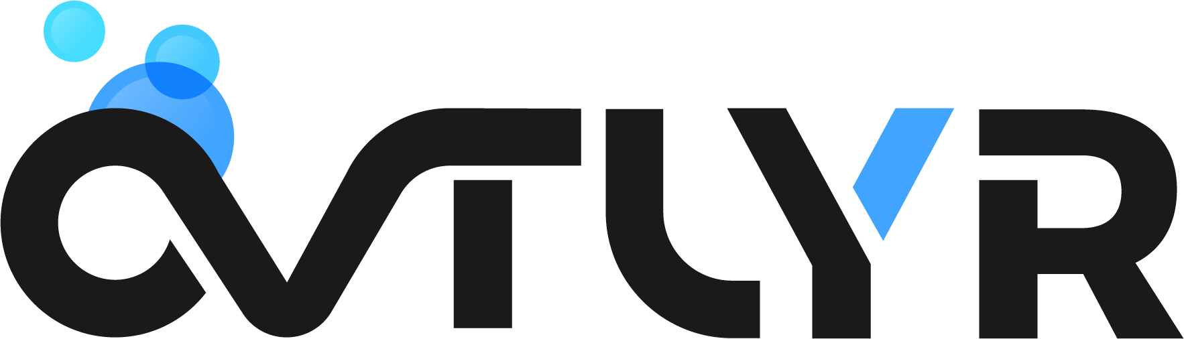

Home About Resources Hi, [Name]
Vector Image
Clarity for Stock Investments
Empowering Smart Investors
with Leading Behavioral Data
Email
Register Now
* Free 2021, No Billing Info Required.
Page break

Slide 2


Carousel #1
Animation
Imagine Your Portfolio as an Expensive Camera…
You want to support it with a stable base.
Fundamental & technical analysis may provide
two legs of support, but without behavioral insights on the market you’re left with a
balancing act.
Page break

Slide 3
Carousel #2
Animation
What is Behavioral Finance?
Behavioral Finance is the study of how psychological influences impact market outcomes.
It’s about knowing how over 200 cognitive biases affect the way you – and every other investor – approach the market.
Page break

Slide 4
Carousel #3
Animation
Why is Behavioral Finance Important?
Think of the market like a lion and everyone interacting with it a gazelle. Lions eat gazelles,
but only from the back of the herd.
Understanding where the “herd” is currently and the next direction it’s most likely to take is priceless when it comes to avoiding the lion’s claws & jaws.
Page break

Slide 5
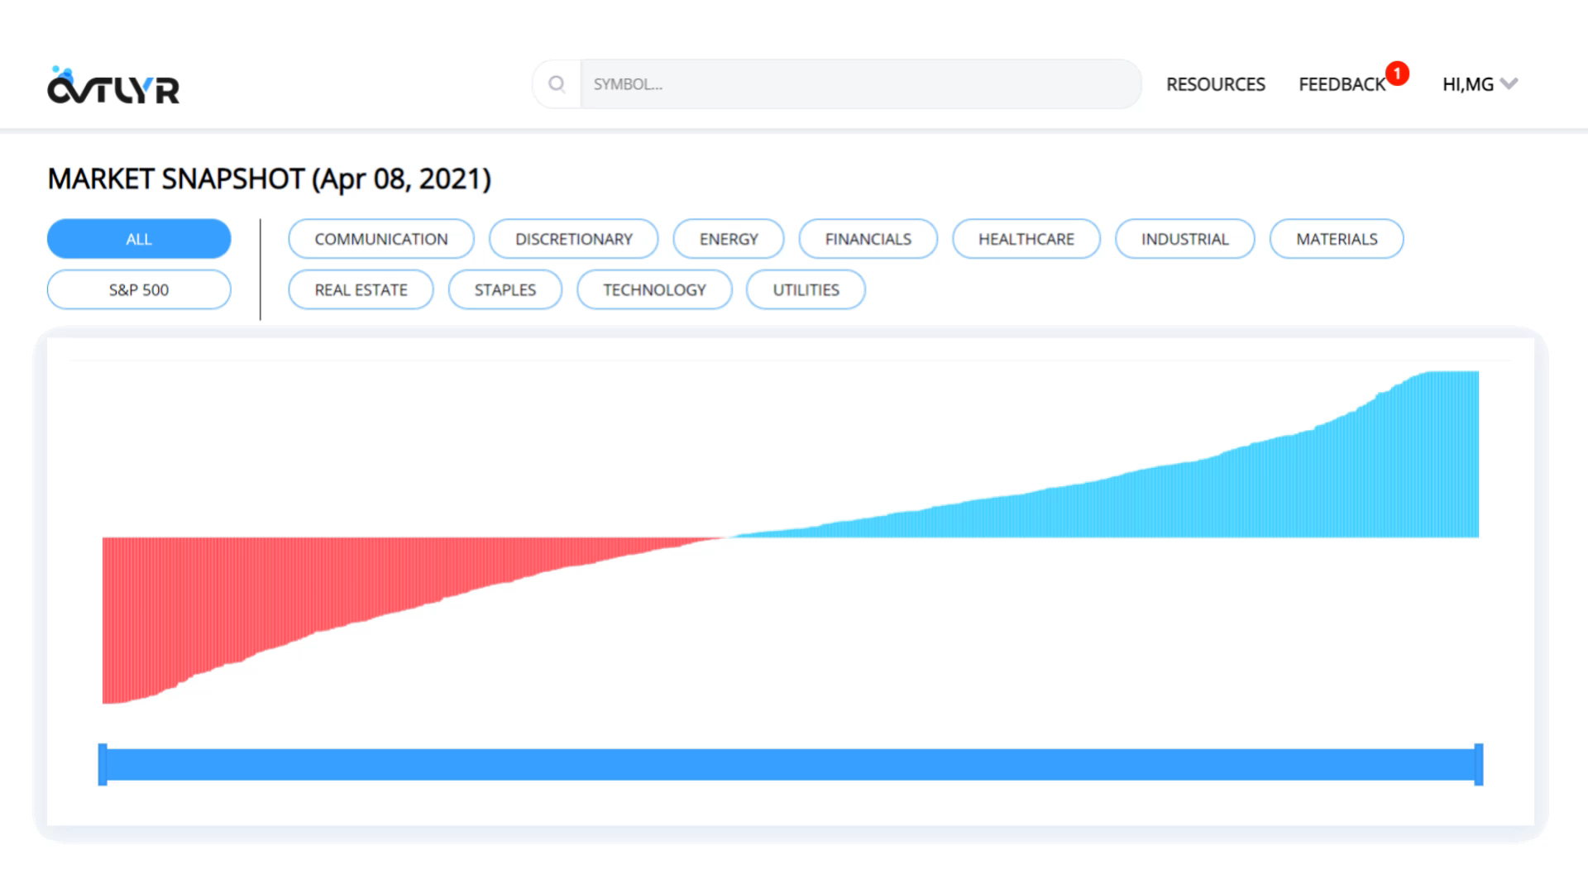
Video
Text…
Text…
Text…
Page break

Slide 6
Join the Thousands Leveraging OVTLYR Data to Bring their Investments into Focus.
Video Testimonials
Page break

Slide 7

What does OVTLYR do?
Markets can move in irrational ways, but irrationality doesn’t have to be a surprise.
OVTLYR uses advanced AI to determine how investors make decisions, so that you can know when the rest of the market has been too fearful or greedy.
Page break

Slide 8

Who is OVTLYR for?
OVTLYR is a tool for people with busy lives. Neither highly active nor completely passive, OVTLYR is responsive when you need it and low-hassle when you don’t.
OVTLYR behavioral analytics are unique to fundamental & technical indicators and can be used with your existing strategy to give you an edge.
Page break

Slide 9

What does OVTLYR cover?
OVTLYR supports over 1,000 of the largest market cap, most liquid assets on the NYSE and NASDAQ exchanges.
See the full list here.
Page break

Slide 10

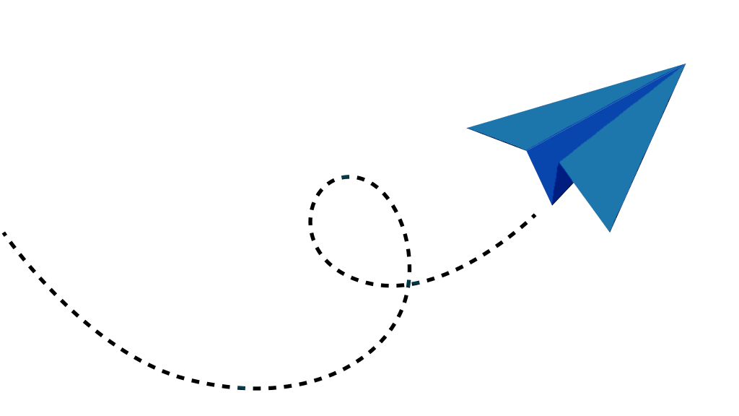
Try OVTLYR Absolutely FREE during
Our Extended Pilot Launch for 2021!
We’re still adding features for the final release, but that’s no reason not
to use the already capable OVTLYR data to improve your equity positions.
Sign up with just an email. No billing info necessary!
No contracts, no obligations. Month-to-month billing for premium plans after 2021.
Join our Pilot!
Page break

Slide 11
It’s Time to Democratize the Power of Behavioral Analytics.
OVTLYR will always offer a free tier with enough insights to help new investors reduce their market risk while building their portfolio WITHOUT an additional price burden.
Premium plans will be priced with “aggressive affordability” in mind.
We Need Your Help.
Feedback from our members helps us to build the solutions you want, the way you want it. We LOVE hearing from you!
Page break

Slide 12






Want to Watch our
Co-Founder Manage
His Personal Portfolio
Using OVTLYR?
Page break

Slide 13
F.A.Q.s
Text…
Text…
Text…
Text…
Text…
Page break

